Slide 1

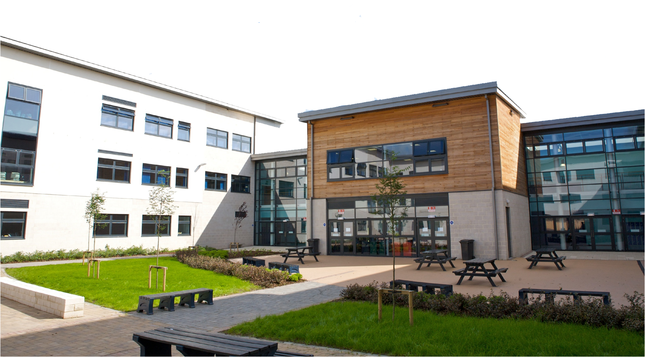


S2 Options Evening
Thursday 12th February 2026

Slide 2
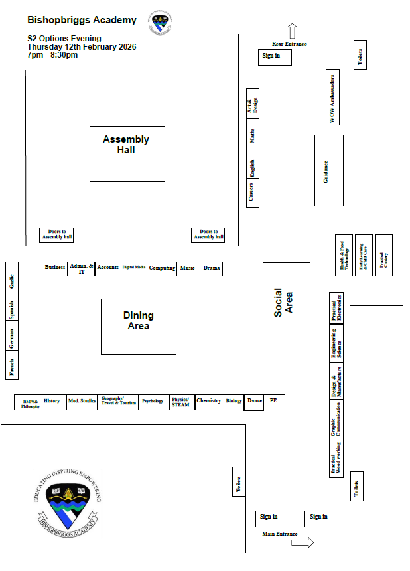
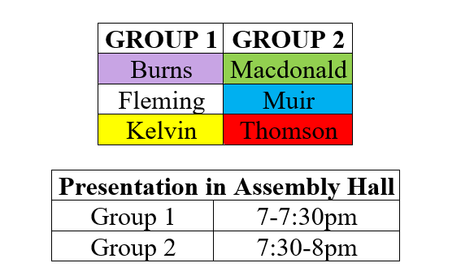
Welcome!

Slide 3
Mr Mark Campbell (DHT, S2 Year Head)
Mr Cameron Carey (Principal Teacher, Pathways)

Slide 4

Important Decision & Support
These choices will influence what subjects pupils study in S4/5/6, which will have an impact on what they do after school.
Advice is available to help pupils to make the best possible choices.

Slide 5
Guidance Team
Teacher House
Mr Rushworth Burns
Mrs S Penman Fleming
Ms Ramage & Mr McNair Kelvin
Ms J McSherry Macdonald
Mrs L Dawson Muir
Mr A Wilson Thomson

Slide 6
Other Key Individuals
Mrs Ailsa Slavin - Principal Teacher, LSR
Mrs Michele Stevenson – Principal Teacher, ELR
Ms Natalie Hendrie – Principal Teacher, DYW
Mr Cameron Carey – Principal Teacher, Pathways
Parents/Carers, family and friends

Slide 7
Careers Advisers
Ms Sandra Fleming and Ms Neve Collins
Skills Development Scotland Centre
New College Lanarkshire
Kirkintilloch Campus
50 Southbank Road
Kirkintilloch
G66 1NH
Tel: 0141 777 5860

Slide 8
Online Support
Some websites to assist with careers research:
www.skillsdevelopmentscotland.co.uk
www.myworldofwork.co.uk
www.planitplus.net
www.prospects.ac.uk
www.ucas.com

Slide 9


Mr Carey/Ms Hendrie, PT DYW
My Role
Promoting Career Education across the curriculum
Organising and facilitating work experience
Promoting helpful career resources

Slide 10

My World of Work Website
This is a website designed to help young people, parents and teachers learn more about career and pathway options.
Most pupils will already be registered.

Slide 11

Useful for Pupils
There are several useful tools for pupils making their option choices. There is a helpful tool for both those who have a career in mind and those who are still unsure!
Option Choice Tool
Great for those without a career in mind yet!
Allows you to enter 8 of your chosen subjects
Generate an overview of possible careers and industries.

Slide 12
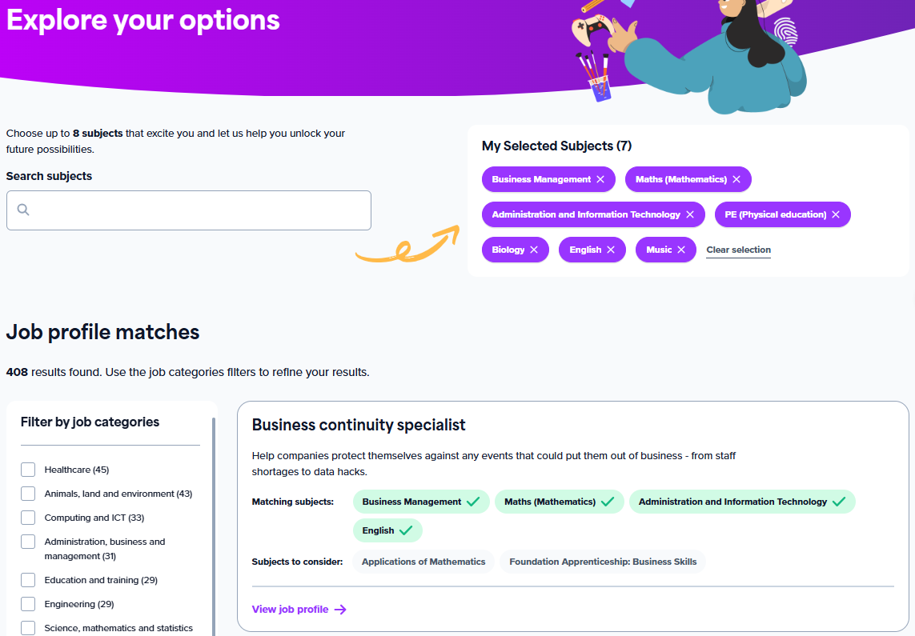
Useful for Pupils
After inputting up to 8 subjects, pupils can view potential jobs, what they involve, estimated salaries and how to get into the sector.

Slide 13
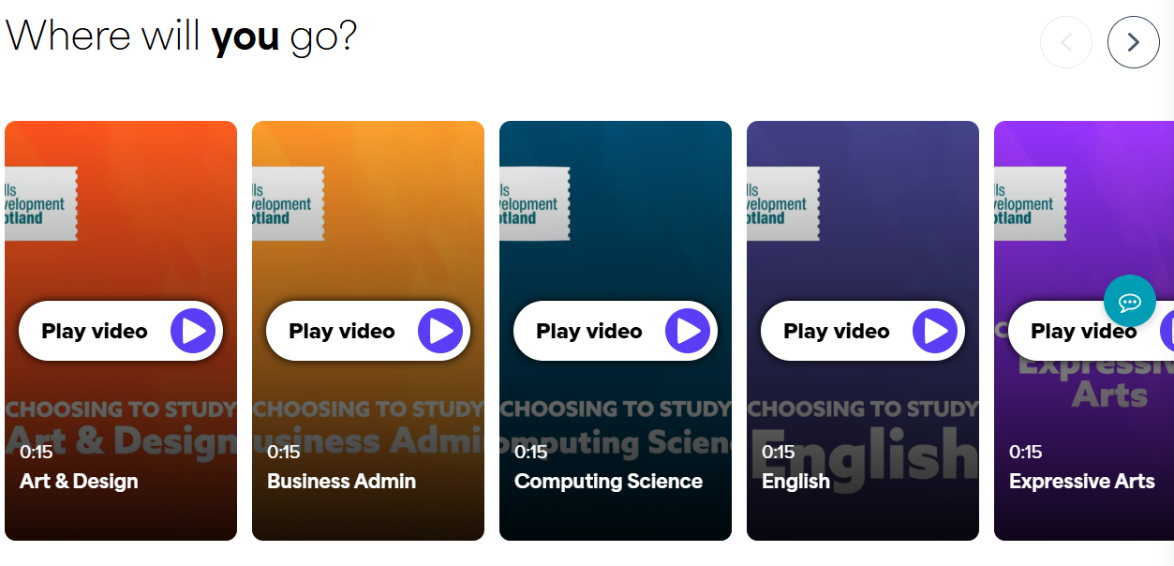
Useful for Pupils
Option Choice Tool
Short videos that show a variety of jobs related to each subject

Slide 14

Useful for Pupils
Explore Careers Tool
Useful for those who have a career in mind
Split up into sections with over 600 careers
Pick any career you would like to know more about and get information on salaries, working conditions as well as useful subjects and qualifications for that career.

Slide 15
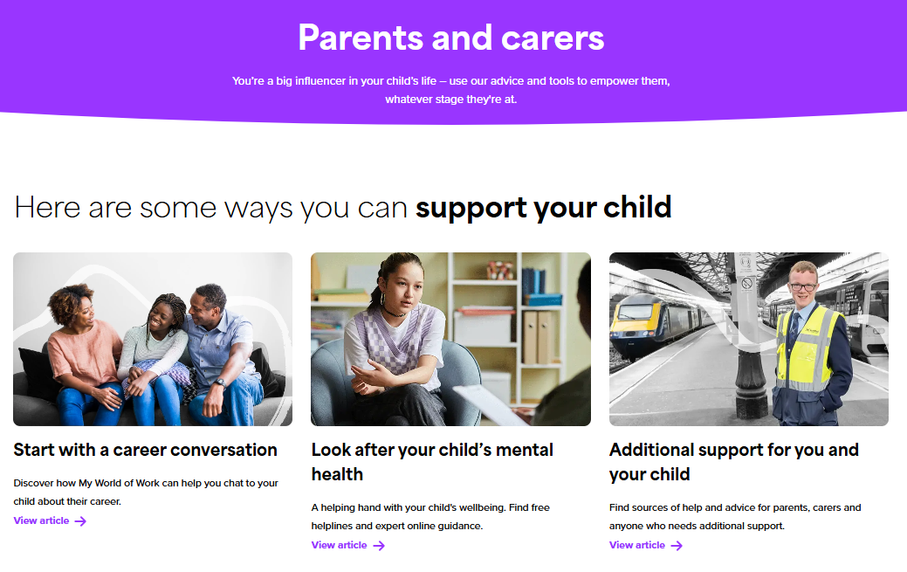
Useful for Parents
Section on how to support your child with their career journey – a great tool for parents to get advice.
You can use the tools and resources to guide your child through their career development:
Option choice tool
Results support
Industry areas
Skills
CV and Application advice
Info on routes/pathways
Webinars

Slide 16
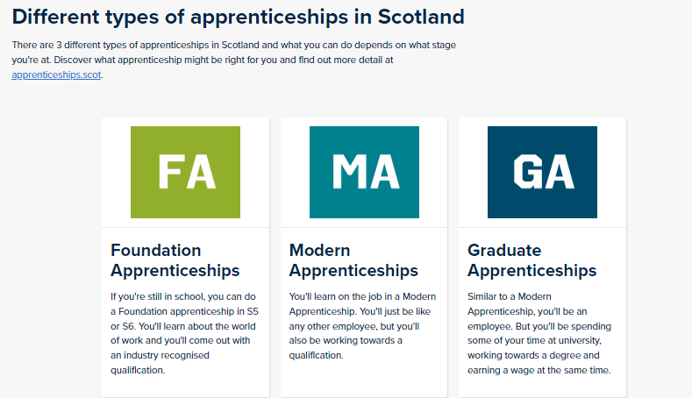
Useful for Parents
Apprenticeship Information
Part of the routes and pathways section in the Parents and Carers section of My WOW Website

Slide 17
Curriculum for Excellence: a two phase model
S1 – S3: Broad General Education
S4 – S6: Senior Phase (SQA Certification)

Slide 18
Context - The story so far…
Your child has been experiencing the Broad General Education in S1-2 and this will continue into the early stages of S3.
The Broad General Education includes Experiences & Outcomes across eight curricular areas up to and including the third level. These should be experienced by all pupils, as far as this is consistent with their learning needs and prior achievements.

Slide 19

The Eight Curricular Areas
Expressive Arts
Health and Wellbeing
Languages
Mathematics
Religious and Moral Education
Sciences
Social Studies
Technologies

Slide 20
Progression from the BGE to the Senior Phase
The BGE option form provides the opportunity for pupils to make choices that will allow them to continue to study each of the eight curricular areas.
Pupils will progress from level 3 or 4 Experiences & Outcomes to the appropriate National Qualifications.
Early preparatory work for National Qualifications at levels 4 and 5 will begin in S3.
By the end of S4, pupils will be presented for either National 4 or 5 in their chosen subjects.

Slide 21
Relationship between BGE and Qualification Levels
BGE
Levels
Qualification
Levels
Higher
National 5
≈
4th Level Es and Os
National 4
3rd Level Es and Os
National 3
2
2
Early
years
1
1

Slide 22
Progression
S3 | S4 | S5 | S6
Achieved Level 4 | National 5 | Higher | Advanced Higher
Achieved Level 3 | National 4 | National 5 | Higher
Achieved Level 2 | National 3 | National 4 | National 5

Slide 23
S2 – S3 Options Choice
15 Subjects in S2 will reduce to 9 in S3
+ PE, PSE and RMPS

Slide 24
Preparation for Choice
  PSE programme
  Guidance support
  Careers support
  Assemblies
  Monitoring & Tracking updates
  Parents night – Online & In person

Slide 25
Preparation for Choice
  Practise Option Form
    Paper copy
  Options Evening – 12th Feb.
  School website
    This presentation
    Option Choice Form
    S2-S3 Options Booklet
    Subject Progression Information

Slide 26



Slide 27
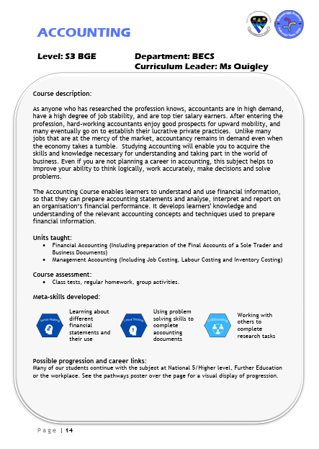
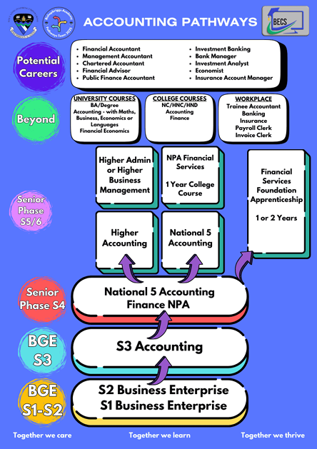

Slide 28
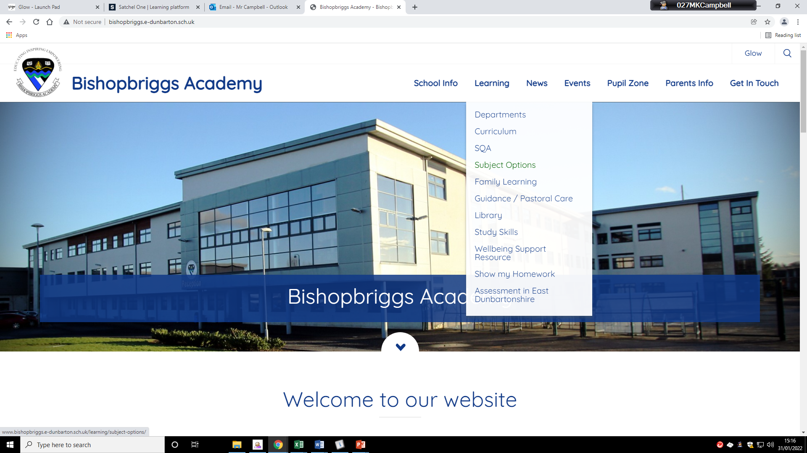

Slide 29
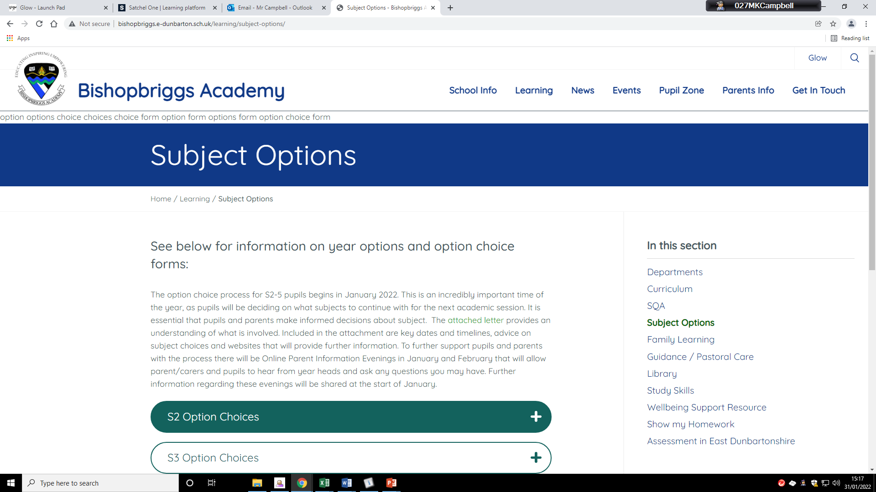

Slide 30
Good reasons to choose a subject
Ability – What are you good at?
Enjoyment – What do you enjoy?
Related to possible Further/Higher Education
Related to possible career

Slide 31
Poor reasons to choose a subject
Your friends are taking it
You do/don’t like certain teachers
Your parents do/don’t want you to do it
It sounds good (but you don’t know much about it)

Slide 32
Completing the option form
Several years ago we moved to an electronic option form and is completed through Microsoft Forms
Paper copies available for reference
Mr Campbell will post a link to the form on Satchel:One on 13th February
Forms must be submitted by Tuesday 24th February

Slide 33
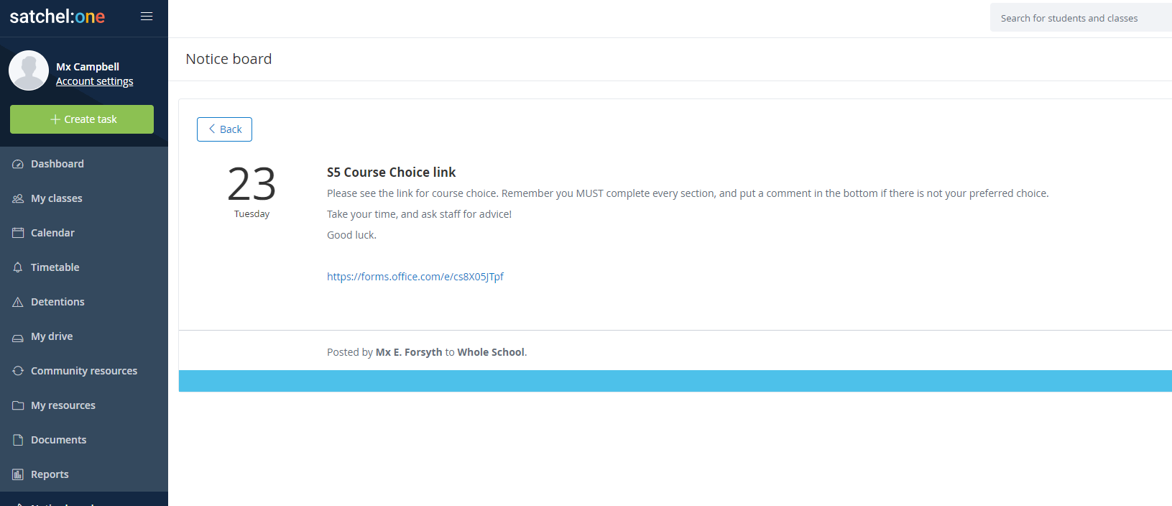
1. Accessing the form
Mr Campbell will post a notification on both Satchel:One
Only S2 pupils can access the form

Slide 34
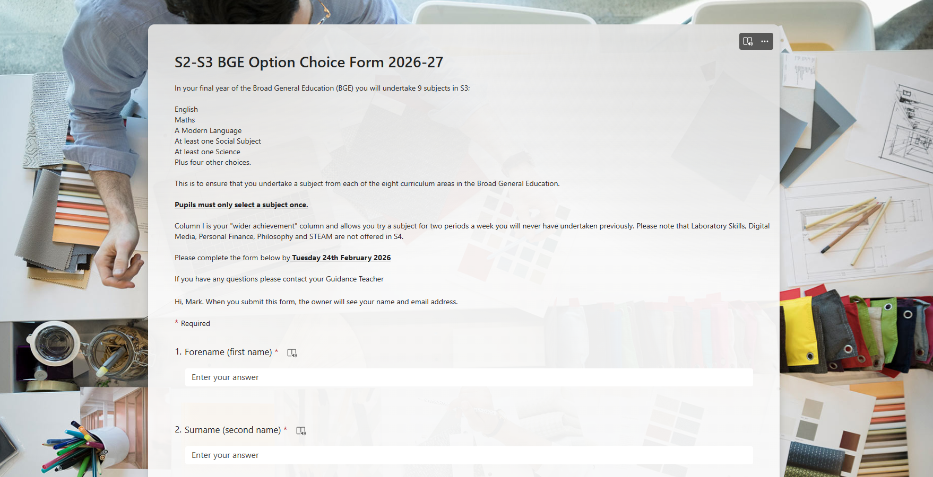
2. Completing the form
Please read over the instructions at the top
with your child and complete all sections.

Slide 35

2. Completing the form
2. Select one subject in each column, take care not
to select the same subject twice.

Slide 36
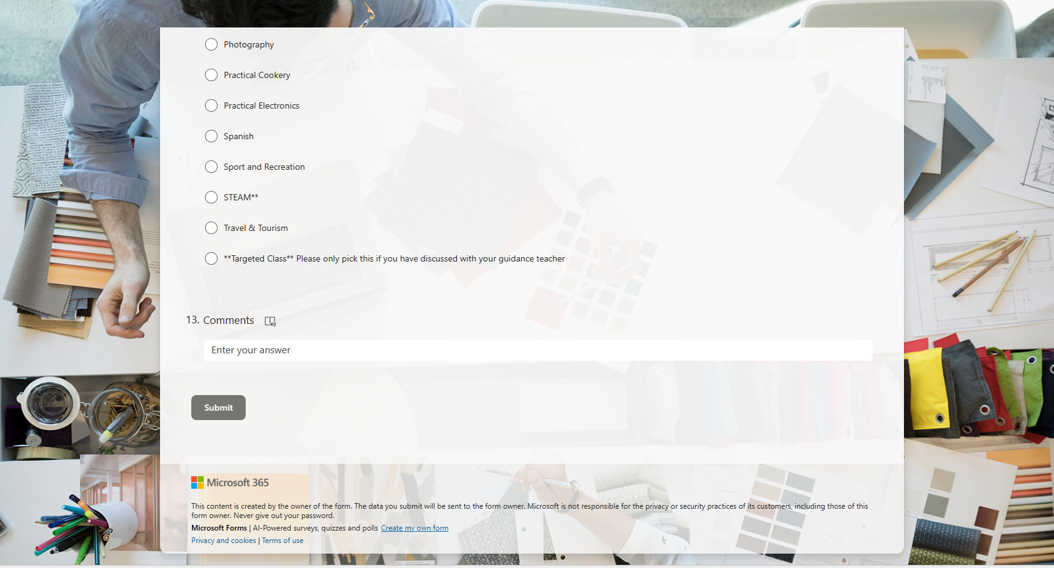
2. Completing the form
3. Check over the choices before submitting, add a comment if you have one then hit “submit”.
Eg I would X instead of Y in column Z

Slide 37
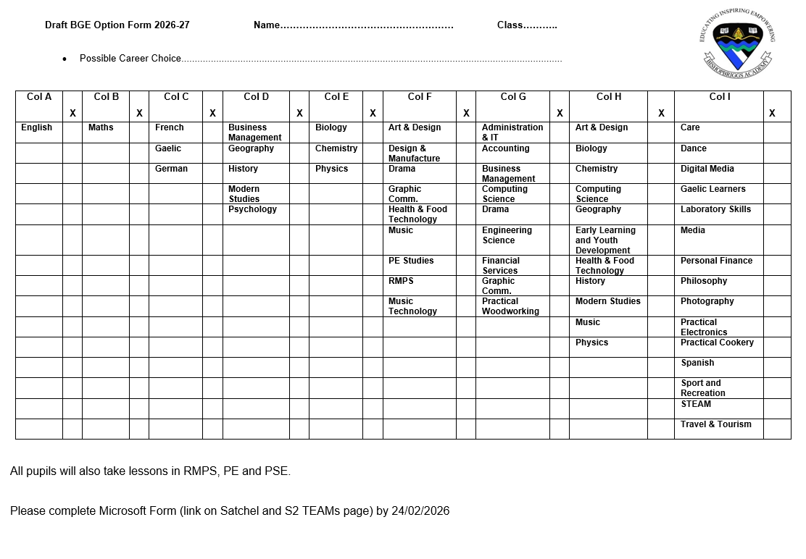
The form can be accessed on the school website for an overview of the choices available.

Slide 38
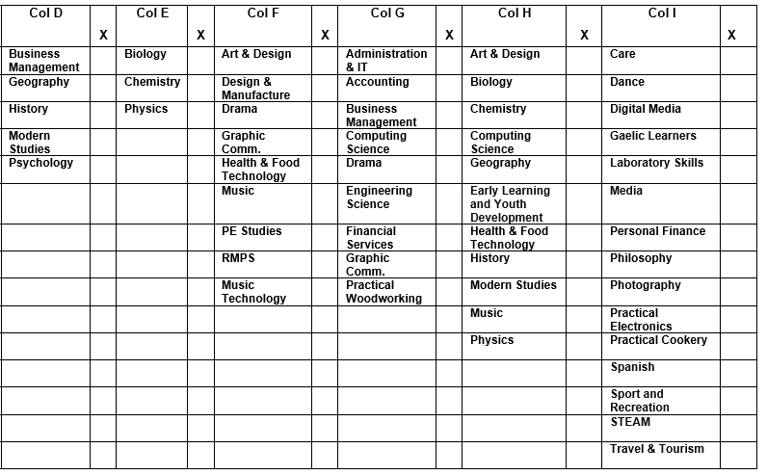

Slide 39
Questions

Slide 40
Welcome!

