Slide 1





Together we care
Family Wellbeing Evening
Together we care, together we learn, together we thrive

Slide 2
Family Wellbeing Evening
6- 6.15pm : Opening remarks - I.Ross, DHT
6.15 - 6.45pm: Body Image: We are more than what we look like
– Julie Cameron, Associate Director of the Mental Health Foundation
6.45 – 7.05pm: Interval
7.05- 7.35pm: Optimizing Future Thinking
- Dr Jala Rizeq, Senior Lecturer in Clinical Psychology at Glasgow University
7.35-8.05pm: Nurturing a Resilient Teenage Brain
–Danny Gemmell, Founder/Director of Be-Inn Unity
8.05 – 8.15am: Closing remarks - I.Ross, DHT

Slide 3


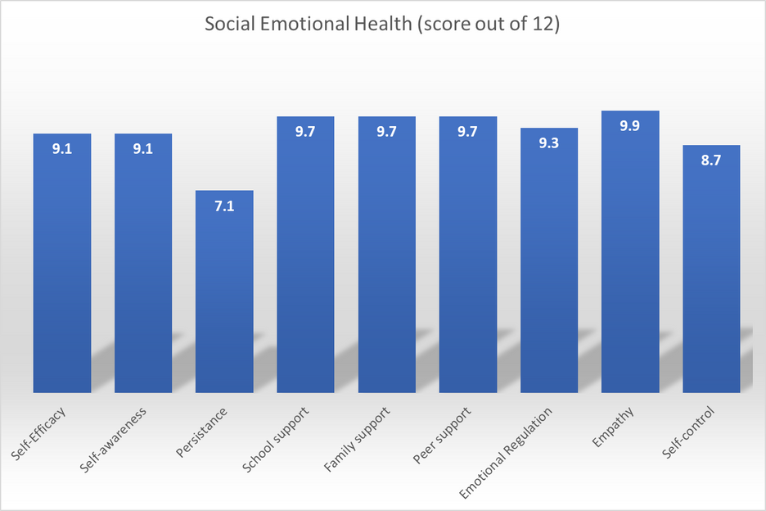
The last three years of the SHINE data has shown an improving picture for pupil’s
mental health and wellbeing.
2024-25
This scale measures different competences of positive socio-emotional health, which are fundamental for
young people to develop to live engaging and meaningful lives.
Notes:
This scale measures different competences of positive socio-emotional health, which are fundamental for young people to develop to live engaging and meaningful lives.

Slide 4
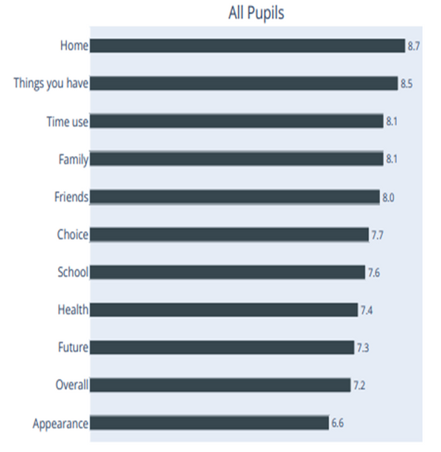
Although improving,
some areas of mental
health and wellbeing
have continued to
receive the lowest
scores.
2022-23

Slide 5
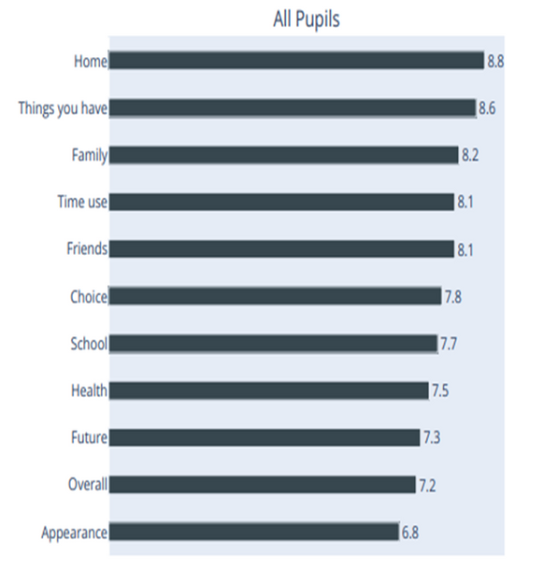
Although improving,
some areas of mental
health and wellbeing
have continued to
receive the lowest
scores.
2023-24

Slide 6
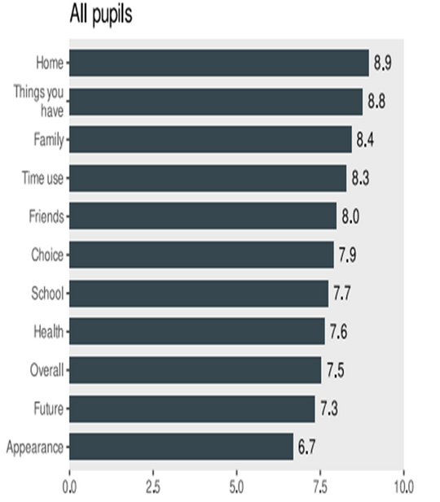
Although improving overall,
some areas of mental
health and wellbeing
have continued to
receive the lowest
scores.
2024-25

Slide 7
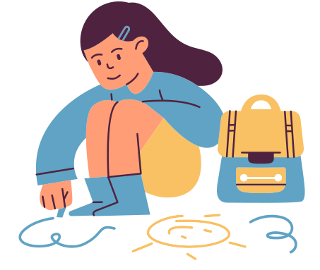

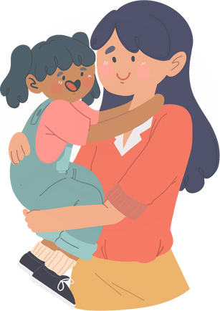
Together we care
supporting young people and each other
Young People
Staff
Parents/Carers
  S5/6 Wellbeing Ambassadors
  All staff
  Lifelink counselling
  Tracking Wellbeing
  SHINE survey
  SCQF Mental Health
First Aid
  CIRCLE implementation
  The Promise
  Equally Safe at School
  Pupil Support Team/SLT
  P7/S1 info evenings
  S2 Options evening
  Senior Phase info
evenings
  Tonight!

Slide 8
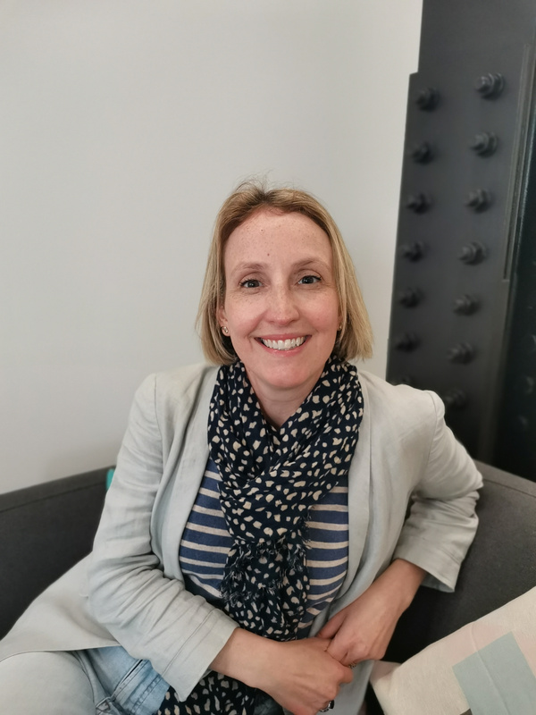

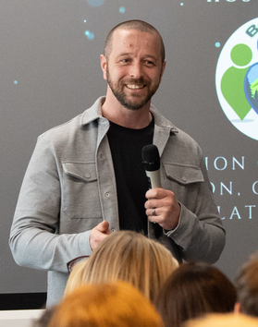
Together we care

Slide 9
Body Image: We are more than what we look like
– Julie Cameron, Associate Director of the Mental Health Foundation

Slide 10

Body Image: we are more than what we look like
Julie Cameron, Associate Director
Mental Health Foundation
September 2025

Slide 11

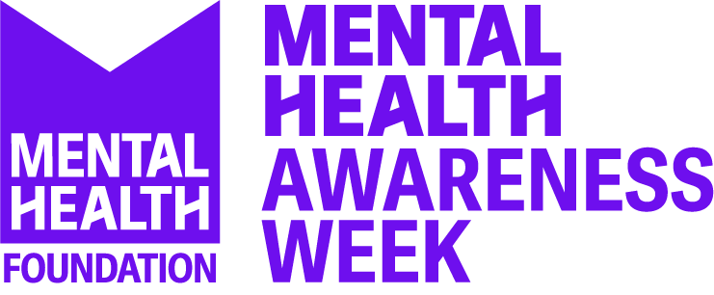
Who we are
At the Mental Health Foundation, we know that poor mental health is not inevitable.
We believe that no-one living the UK should be deprived of good mental health because of who they are, the community they come from or where they live.
We’re challenging the way things are done and creating fundamental change in the UK’s approach to mental health,
to build a society where everyone can thrive.
We’re the home of Mental Health Awareness Week.

Slide 12


Understanding Body Image
"Beauty begins the moment you decide to be yourself."
— Coco Chanel

Slide 13
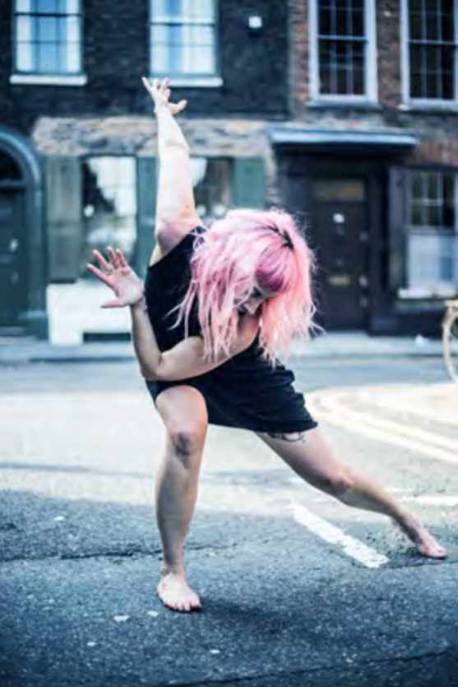
What is Body Image?
Definition of Body Image
Body image is how we think and feel about our body.
Influence During Adolescence
  Body image is especially impactful for young people as they face puberty new influences and social challenges.
Factors Affecting Body Image
  Body image is affected by age, gender, ethnicity, disability, sexuality and wider aspects of identity. It evolves due to personal experiences, peer influence, life transitions and media exposure over time.

Slide 14
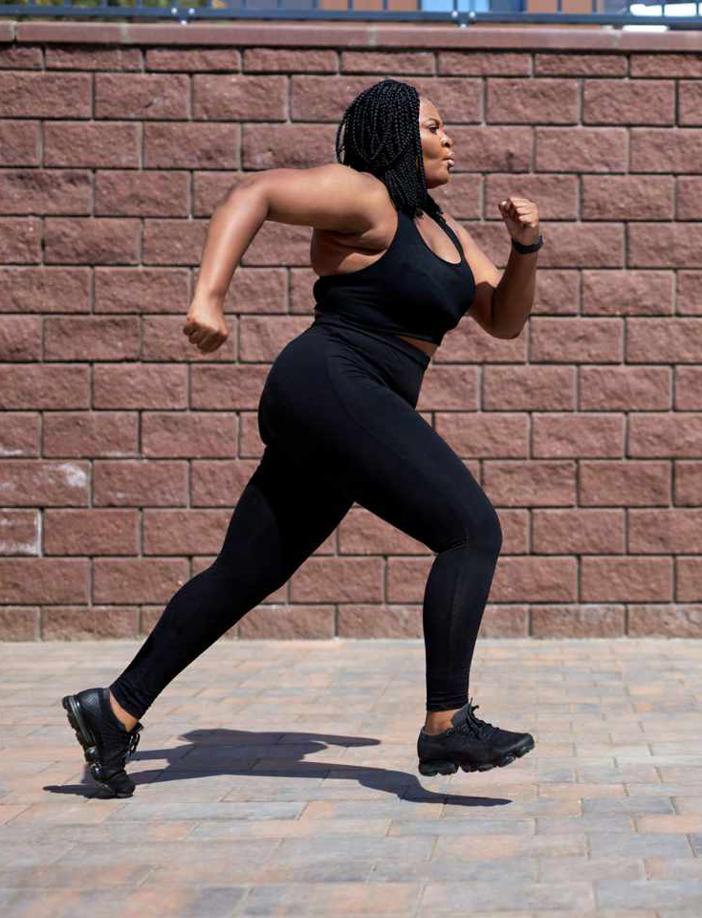
What is Good Body Image?
Acceptance and Appreciation
  Good body image is accepting how our body looks and valuing what it can do, recognising that we are much more than what we look like.
Valuing Body Functionality
  Focus on the body’s strength, resilience, and abilities rather than just appearance.
Building Resilience in Youth
  Young people learn to appreciate diversity and filter negative media and peer influences. Accepting and appreciating their body beyond societal beauty standards.
Role of Parents and Support
  Parents model positive attitudes and foster open conversations to nurture good body image.

Slide 15
Challenges to Body Image
"You are imperfect, permanently and inevitably flawed. And you are beautiful."
— Amy Bloom, Author

Slide 16
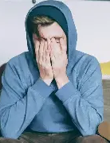
What influences poor body image?
Impact of Social Media
  Social media sets unrealistic beauty standards causing comparisons and lowering self-esteem among youth.
Advertising and Celebrity Culture
  Advertising and celebrities promote narrow beauty ideals that harm individuals' body image and confidence.
  Commercialisation is a huge challenge with ‘quick fixes’, beauty and weight loss products BIG business.
Peer and Family Influence
  Bullying, teasing, and family comments about appearance shape adolescents' body perceptions negatively.
Cultural and Societal Norms
  Cultural norms often promote unattainable body ideals, affecting self-esteem widely across communities.
Notes:
Norms are different

Slide 17
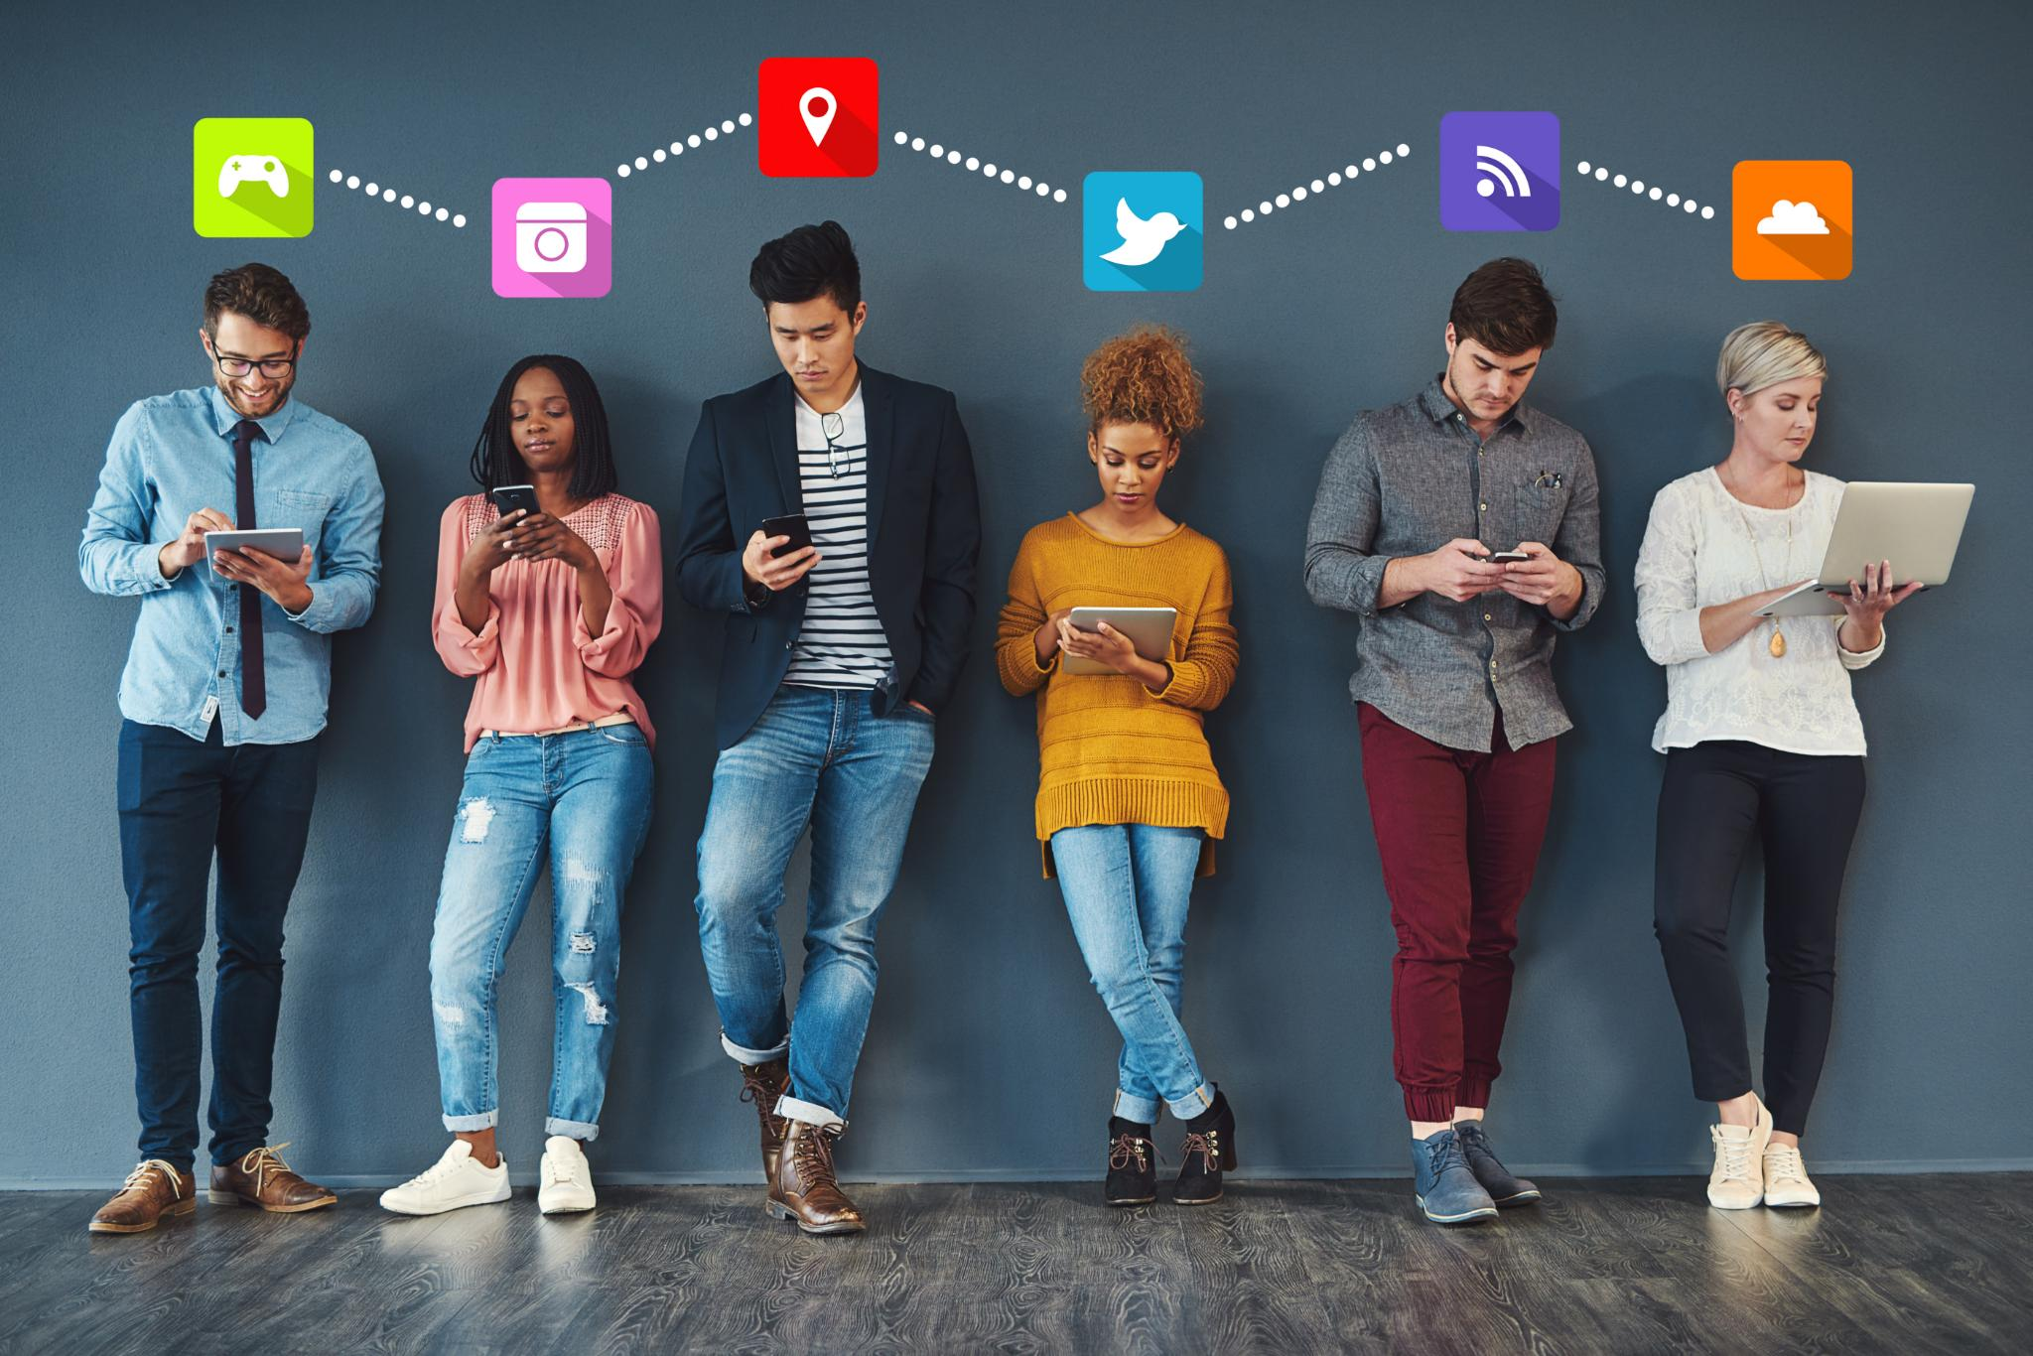
Social media’s role
Impact on Body Image
  Social media promotes unrealistic beauty standards that can increase self-criticism and dissatisfaction among young people.
Validation and Emotional Pressure
  The desire for likes and comments can intensify feelings of pressure and comparison among young users.
Positive Communities and Support
  Social media can foster supportive communities by sharing diverse, uplifting content to encourage positivity.
Parental and Media Literacy Role
  Parents can encourage critical thinking and healthy boundaries to create a safer social media experience for .

Slide 18



What do young people tell us?
27%
40%
57%
10%
of 10-19 year olds said they “always” or “often” worry about their body image
of 11-16 year olds experienced appearance-based bullying on weekly basis. For over 50% started by age 10
of adolescents
had considered dieting, and 10% had considered cosmetic surgery.
Of secondary school boys said they would consider taking steroids to change their appearance
Notes:
13% of teenagers reported experiencing suicidal thoughts or feelings due to body image concerns.
Source: Mental Health Foundation & YouGov, 2019
10% of secondary school boys said they would consider taking steroids to change their appearance.
Source: Credos, 2016
57% of adolescents had considered dieting, and 10% had considered cosmetic surgery.
Source: Be Real Campaign, 2017
Appearance-based bullying affects over half of UK 11–16-year-olds, with 40% experiencing it weekly and 54% saying it started by age 10.
Source: Be Real Campaign, 2018
Adolescents who were cyberbullied were twice as likely to consider themselves “too fat”.
Source: Kenny et al., 2018

Slide 19
Mental Health Implications
"Your body hears everything your mind says. Speak kindly to yourself.“ unknown

Slide 20
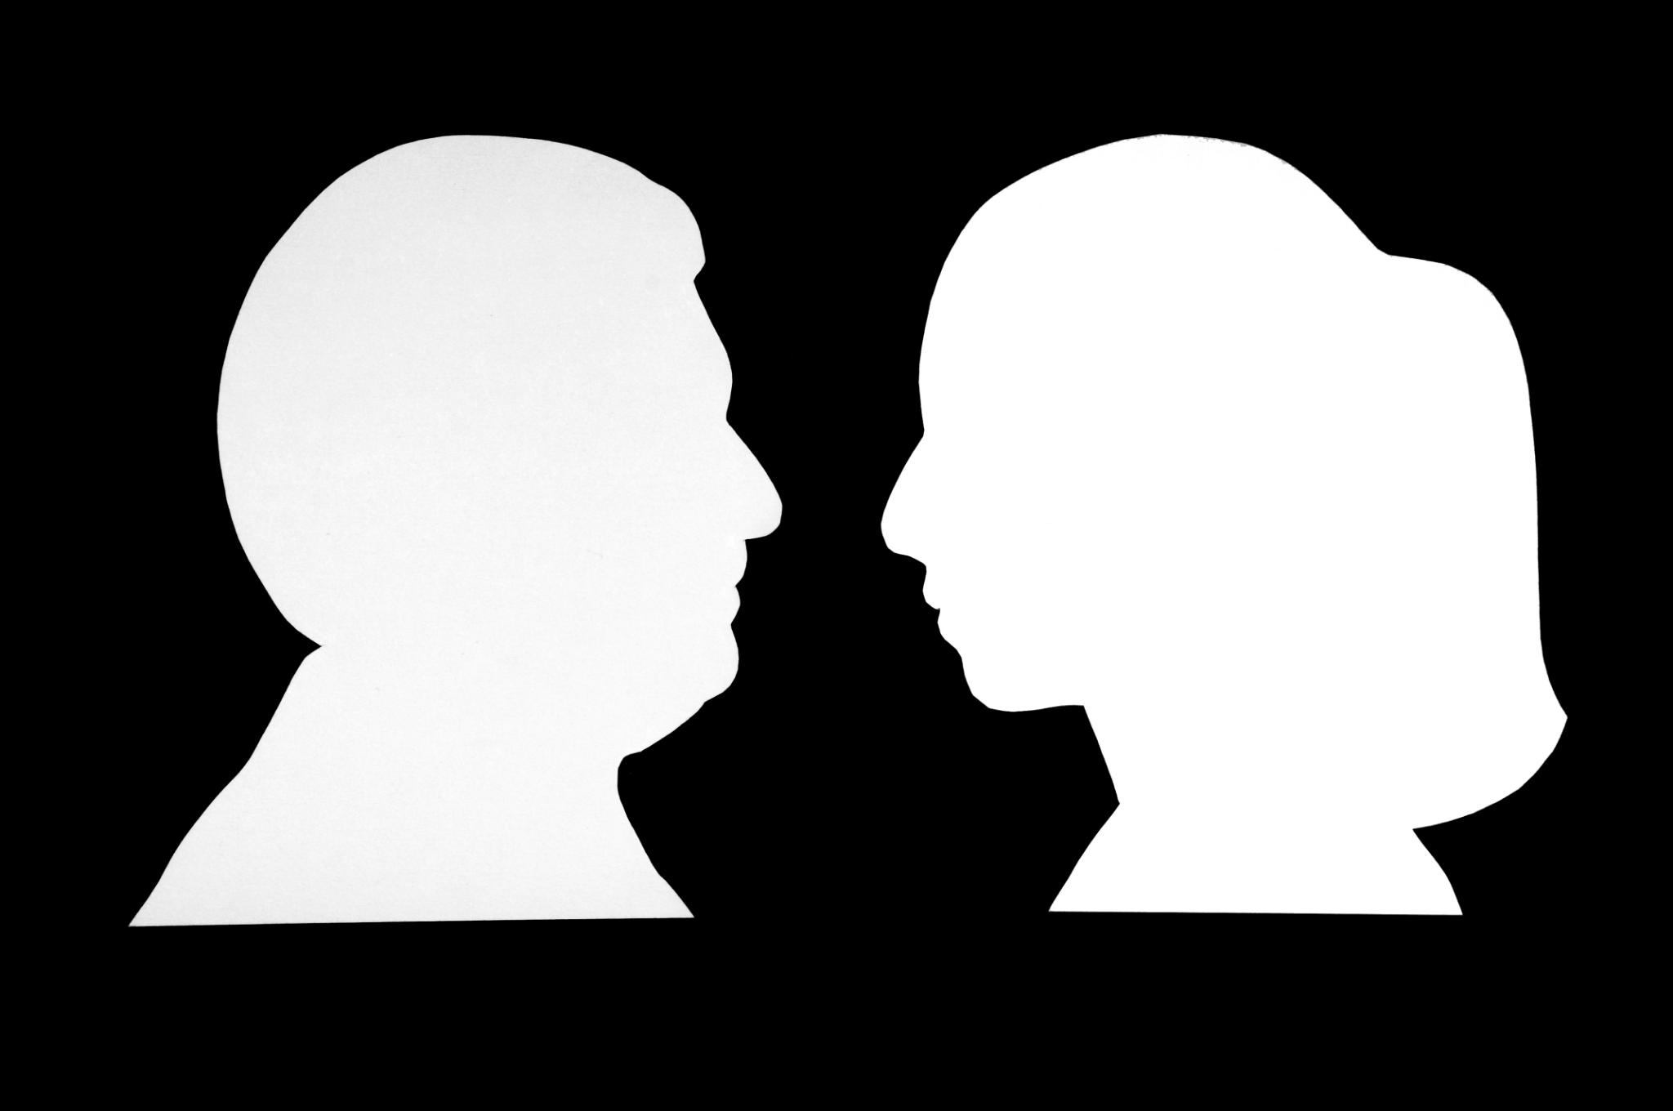

Risks to mental health and emotional wellbeing
Body Image and Mental Health – Poor body image is linked to anxiety, depression, low self esteem and disordered eating in adolescents , some individual examples of change.
Emotional and Social Effects - body dissatisfaction can cause emotional distress, social withdrawal, and avoidance of activities.
Risky Behaviours – Concern over appearance can lead to extreme dieting, over-exercising and self harm behaviours
Importance of Support – Early intervention and supportive environments help protect mental health and build resilience.

Slide 21
Practical Strategies
"Loving your body only when it’s ‘perfect’ is like loving your children only when they behave."
— unknown

Slide 22
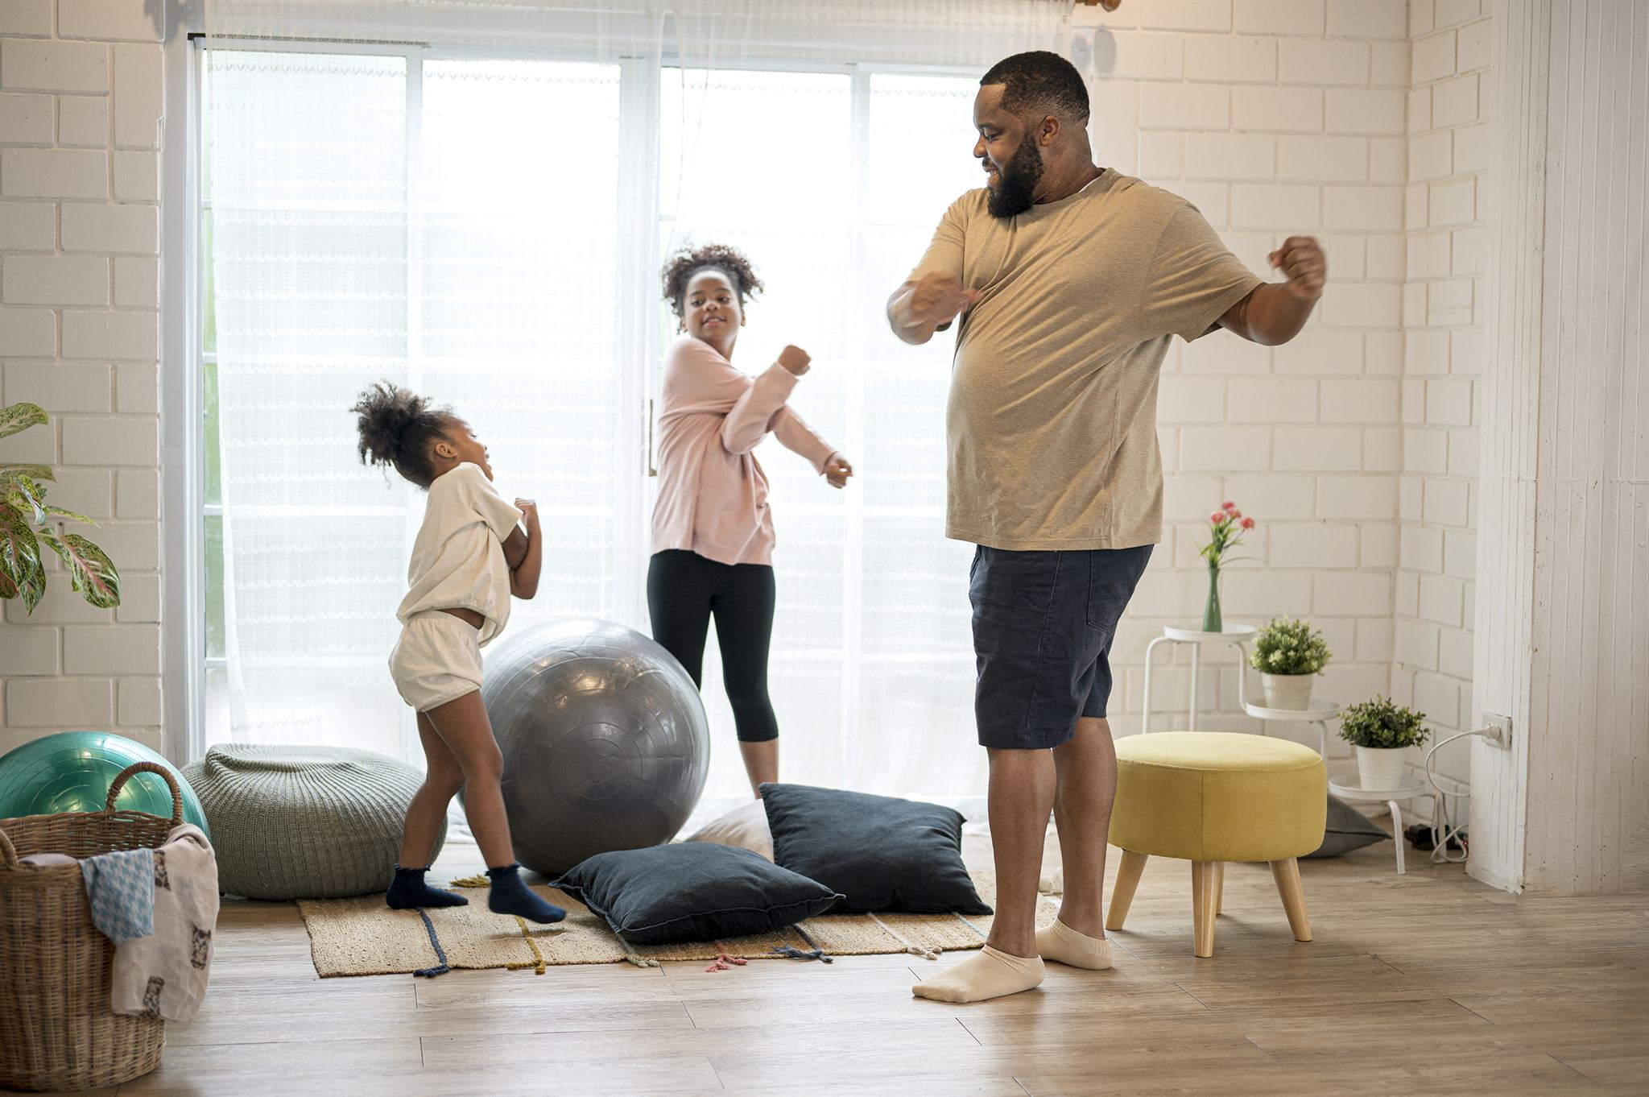
Tips for parents
Positive Behaviour Modelling
  Model positive attitudes about body image and avoid negative comments about weight or appearance.
Encouraging Healthy Habits
  Focus on promoting healthy lifestyle habits without emphasising weight or appearance.
Open Conversations and Media Guidance
  Discuss body image and media influence openly, guiding children to uplifting and diverse social media content. Put in boundaries around social media use.
Creating Safe Supportive Spaces
  Build safe environments where children feel valued, heard, and supported to develop self-worth and resilience.

Slide 23
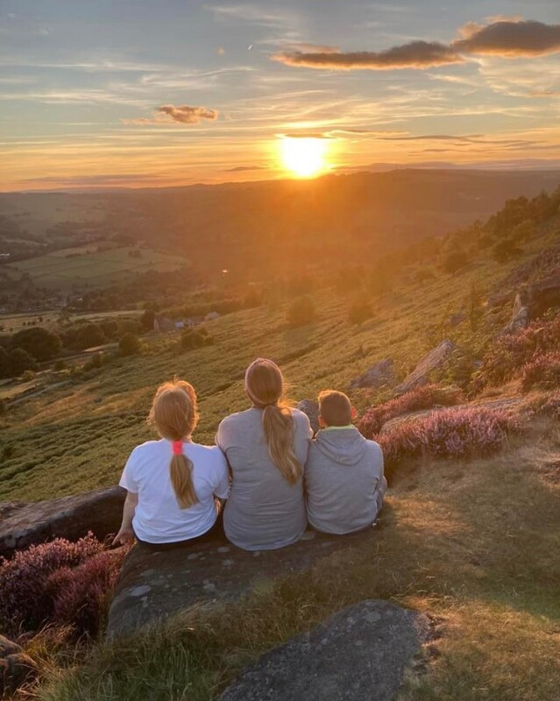
Tips for young people
Normalising Body Image Struggles
  Be kind to yourself. Body image struggles are common and feelings about your appearance will change over time.
Curate Positive Media/Educate self
  Follow diverse, positive social media content and take SM breaks. Cut out the haters/feeds that make you feel bad. Understand algorithms and addictive nature of some apps.
Self-Care and Confidence
  Engage in joyful activities and practice self-care to promote confidence and wellbeing.
Supportive Relationships
  Open conversations with trusted friends and adults to share worries and build your inner resilience.
Notes:
Key questions:
On social media I am… face-to-face I am…
When I am on social media/app/feed I feel and I behave…

Slide 24
Conclusions and Resources
"You are more than a number on a scale. You are strength, resilience, and joy."
— Mental Health Foundation

Slide 25

Final Thoughts and Resources
Lifelong Body Image Journey
  Body image develops from childhood through adolescence and is influenced by personal, social, and cultural factors.
Role of Families
  Parents and carers positively shape body image by fostering acceptance, understanding, and supportive environments.
Importance of Resources
  Access to supportive organisations and resources provides essential tools to promote mental wellbeing and media literacy.
Promoting Open Dialogue
  Encouraging conversations and critical thinking about media influence enhances positive body image among youth.
Notes:
Body image | Mental Health Foundation
MHF-Scotland-Body-image-report.pdf
CYPMH – Professional Learning Resource
Home - Mind Yer Time
Body image | Mental health support | YoungMinds
No Body's Perfect Worksheets (Body image & mental health) - Free Social Work Tools and Resources: SocialWorkersToolbox.com
Parenting teens: Dove Self-Esteem Project resources | Dove
Be Body Positive - Support for Young People, Parents, Carers & Professionals

Slide 26
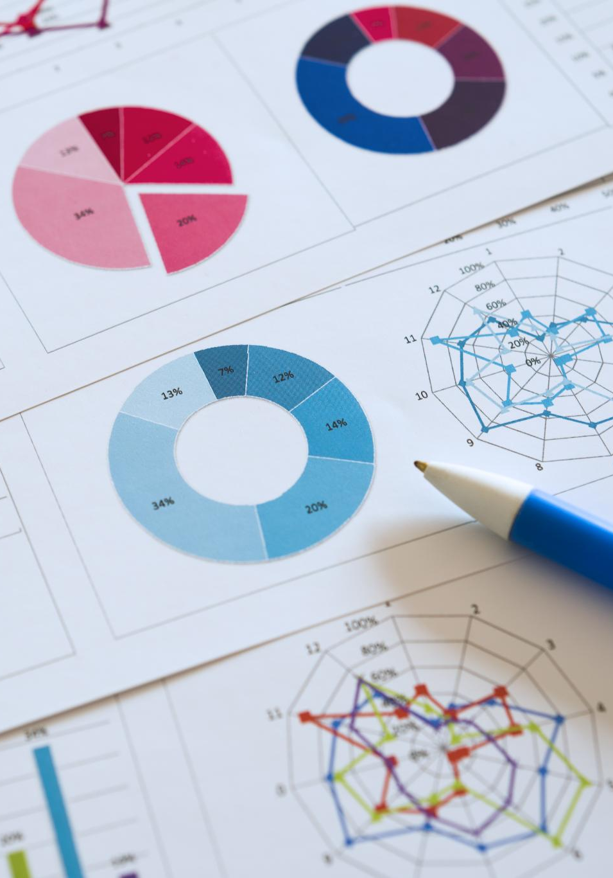
Key research sources
Mental Health Foundation & YouGov
  The 2019 survey offers comprehensive data on body image concerns among UK adults and teenagers. Scot Government report on good body image (2020)
Be Real Campaign Reports
  Reports from 2017 and 2018 reveal young people's attitudes and experiences with body image and bullying.
Academic Studies on Psychological Impacts
  Studies by Sharpe et al. and Rodgers et al. explore psychological effects of body dissatisfaction.
Research on Steroid Use and Cyberbullying
  Credos study examines steroid use among boys, and Kenny et al. analyze cyberbullying effects.
Notes:
The findings presented are based on robust UK research studies and surveys. Key sources include the Mental Health Foundation & YouGov 2019 survey, which provides comprehensive data on body image concerns among UK adults and teenagers. The Be Real Campaign reports from 2017 and 2018 offer insights into young people's attitudes and experiences related to body image and bullying. Additional academic studies cited include Sharpe et al. (2018) and Rodgers et al. (2015) on the psychological impacts of body dissatisfaction, Credos (2016) on steroid use considerations among boys, and Kenny et al. (2018) on the effects of cyberbullying. These sources collectively inform a nuanced understanding of the challenges young people face regarding body image.

Slide 27

Thank you
Julie Cameron
Associate Director
jcameron@mentalhealth.org.uk

Slide 28

Any questions

Slide 29
Nurturing a Resilient Teenage Brain
–Danny Gemmell, Founder/Director of Be-Inn Unity

Slide 30

Nurturing a Resilient Teenage Brain

Slide 31
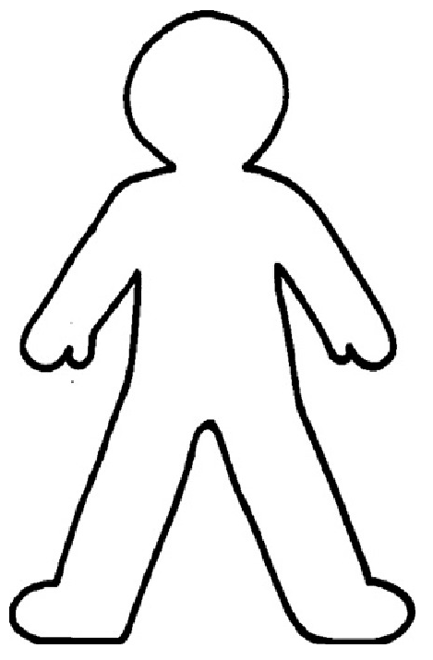
The Life of a Teenager
Peer Pressure
Parties
Sexuality
Puberty
School
Homework
Exams
Being Bullied
Relationships

Slide 32
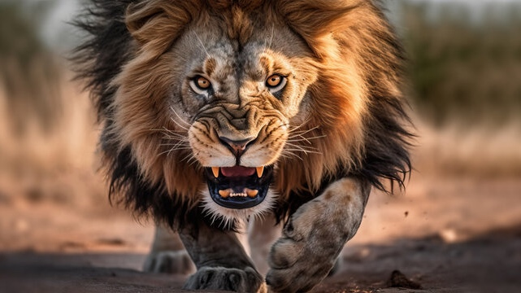
Stress Response System

Slide 33
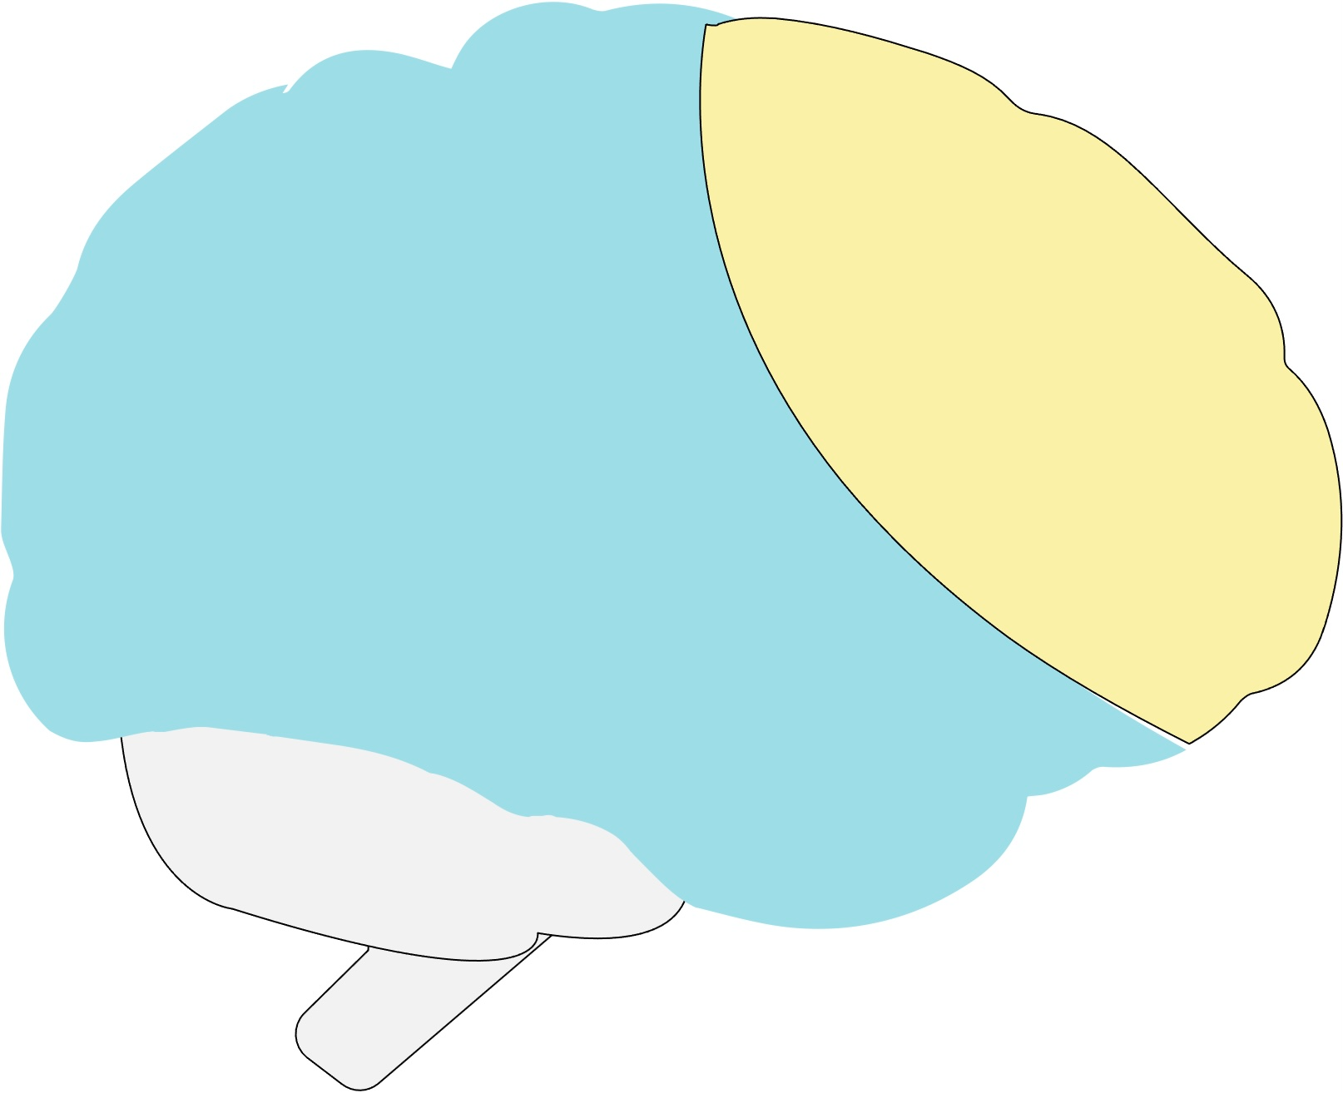
Prefrontal Cortex
Problem Solving
Language
Social Behavior
Executive Function
Inhibiting Behavior
Empathy
Limbic System
Emotions
Reward
Motivation/Memory
Feeling
Brain Stem
Body Functions
HR/Breathing
Connects the Gut

Slide 34

What is Resilience?

Slide 35
Where is Resilience?

Slide 36
Einstein’s Theory of General Relativity

Slide 37
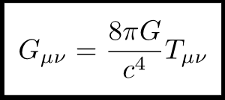

Slide 38
What Does it Mean?

Slide 39
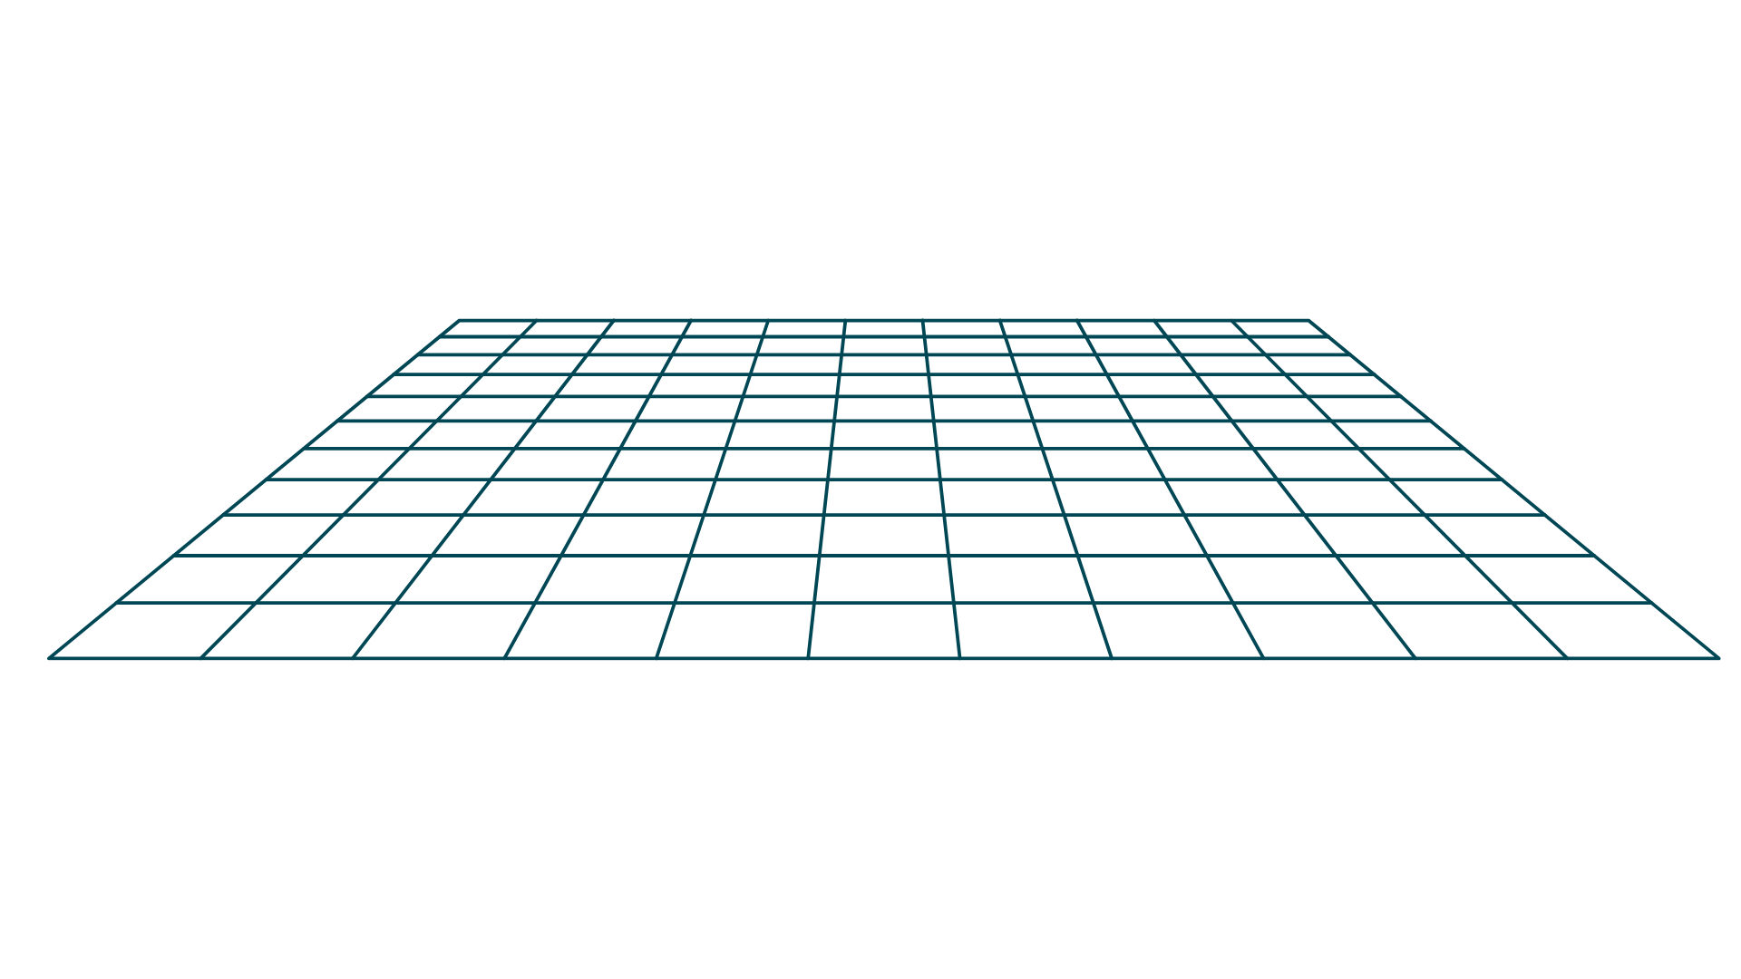
Spacetime Fabric
Mass

Slide 40
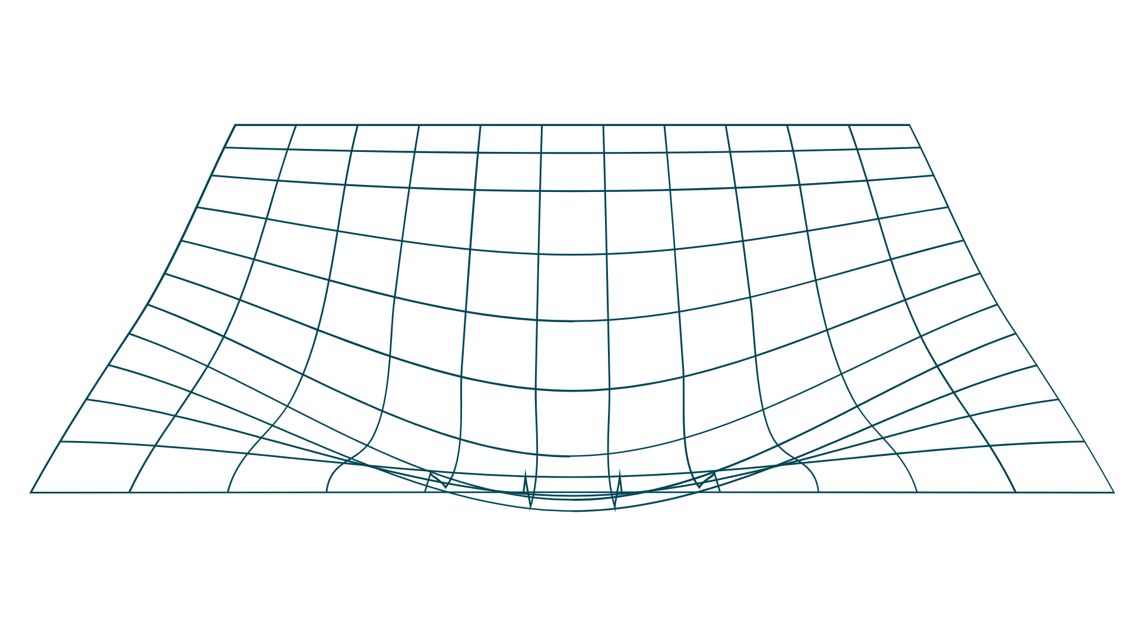
Spacetime Fabric
Mass

Slide 41
Spacetime Fabric
Teenage Experiences

Slide 42
Spacetime Fabric = Resilience Fabric
Teenage Experiences

Slide 43
Resilience Fabric
Adverse Load – Protective Factors
Resilience (Fabric) =
Buffering Capacity

Slide 44
Resilience Fabric
Their Experiences
Tools to Regulate
Teenager
Adverse Load – Protective Factors
Resilience (Fabric) =
Buffering Capacity
You/School/Family

Slide 45
Resilience Fabric = Their Village
Teenage Experiences

Slide 46
Resilience Fabric = Their Village
School
Family
You
Village
Teenage Experiences

Slide 47
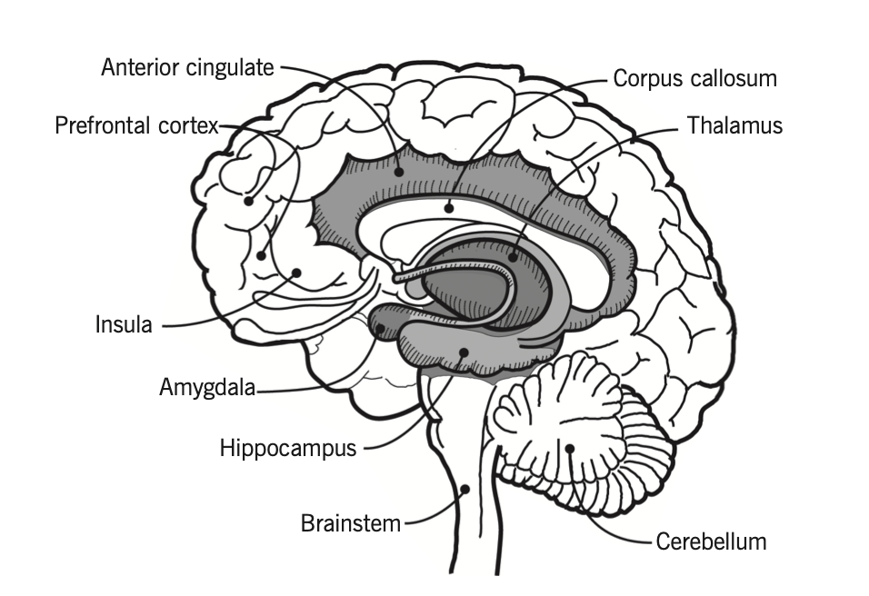

Slide 48
We all belong to each other.
Website: www.beinnunity.co.uk
Twitter (X): Beinn_Unity
Facebook: Beinn.Unity
LinkedIn: Search - Be-inn Unity
Podcast: Connected Communities

Slide 49
Any questions

Slide 50
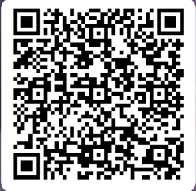
Together we care
Family Wellbeing Evening
Together we care, together we learn, together we thrive

